Slide 1
Concentration
A card sorting implementation on the Epson rc-50

Slide 2
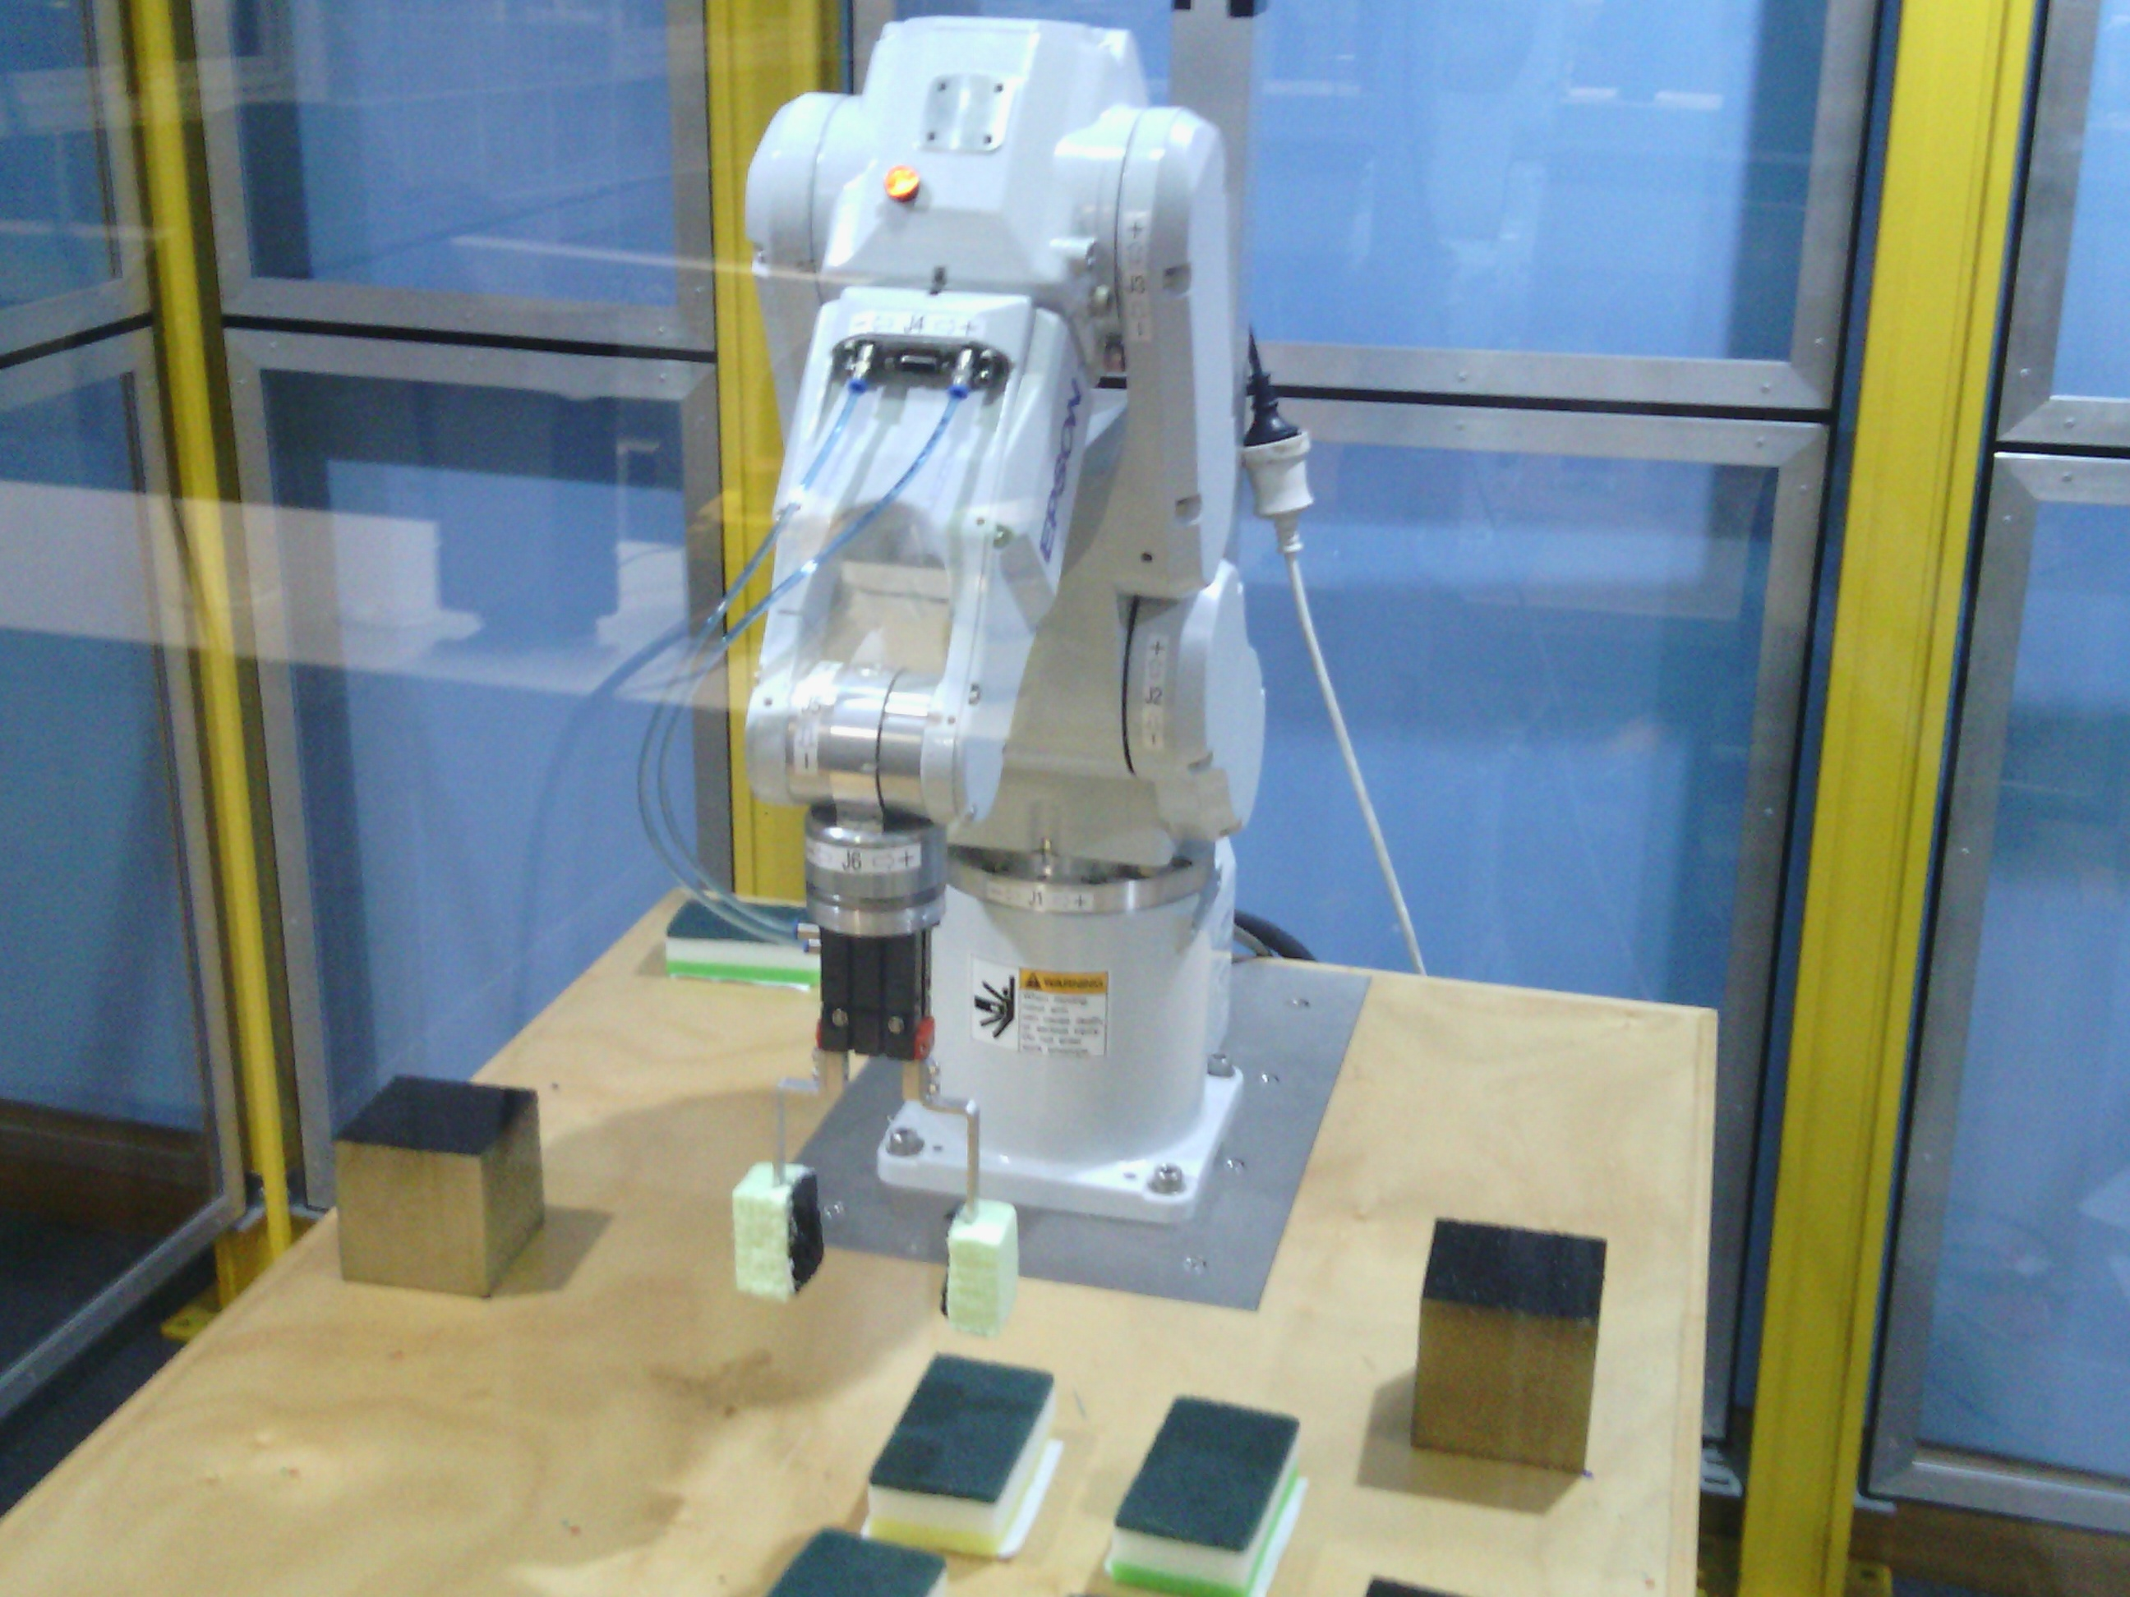
Project Abstract & Motivation
Collection of cards from ‘Set’
Play Concentration (otherwise known as Memory)
Motivation
Robots are perfect for this task (taking memory out of the equation)
Why EPSON RC-50?
Availability
Familiarity
Self-Imposed Real-World Restriction
Why MATLAB?

Slide 3
Project Layout & Responsibility
AI & Program Flow planning – Kausthub
Structure of the AI & defining the necessary functions & file relationships
Version control and module fusion testing
Vision Module – Sachith
Designing and managing the image processing components
Vision Module testing
Motion & Actuation – James
Modifying native EPSON code and designing motion control flow
End effector design
Motion & Actuations testinging

Slide 4
Program Structure and Game AI
Kausthub Krishnamurthy

Slide 5
Considerations & Challenges
Scope of TCPIP connections, video feeds, variable definitions
Modularising the code into reasonable actions
Flow

Slide 6
Vision
Sachith Gunawardhana

Slide 7
Vision
Identify the cards on the table
Face Down cards
Face Up cards
Coordinates & Pose Estimation
Match the local coordinates to the world coordinates
Identify the features of the cards
Shape
Rectangle
Triangle
Filler
Shaded
Block
Ellipse
Not Shaded
No of Shapes
1
2
3

Slide 8
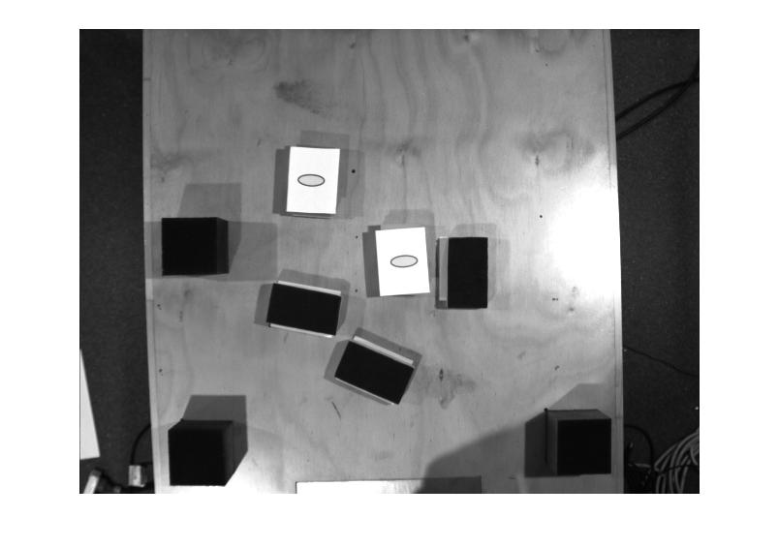
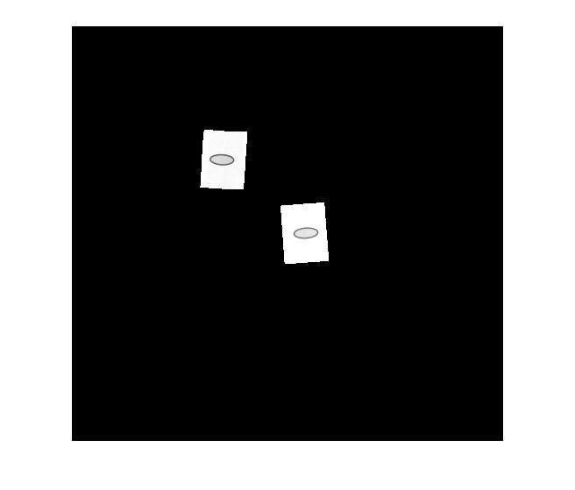
Identify the cards
Used basic histogram equalisation
Used pixel values as a threshold
Create a mask to isolate face up

Slide 9
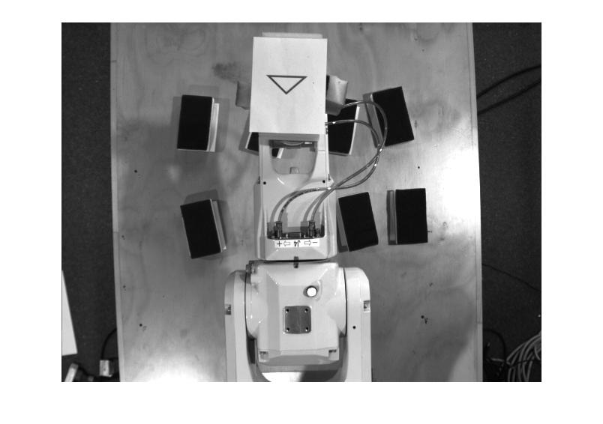
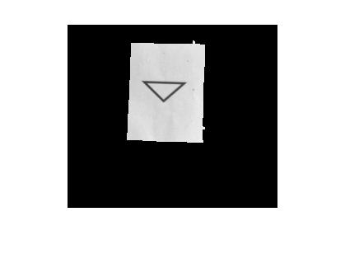
Identify the features of the cards
Create a mask using pixel values for white as a threshold
Extract only the card from the image using a mask and a bounding box

Slide 10
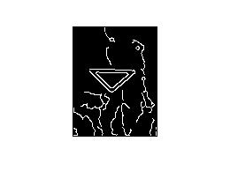
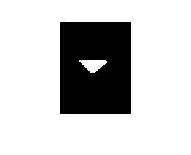
Identify the features of the cards
Detect edges using canny
Remove unnecessary edges from detected edges.
Extract the shape using perimeter value.
Used Mean Intensity for detect the filler status.

Slide 11
Motion
James Ferris

Slide 12
Motor Control
Combination of Epson Program Code and Matlab
Epson for basic motions
Matlab to implement more complicated motions
Move to centroid coordinates
Pick up and position card for imaging
Stack matching pairs

Slide 13
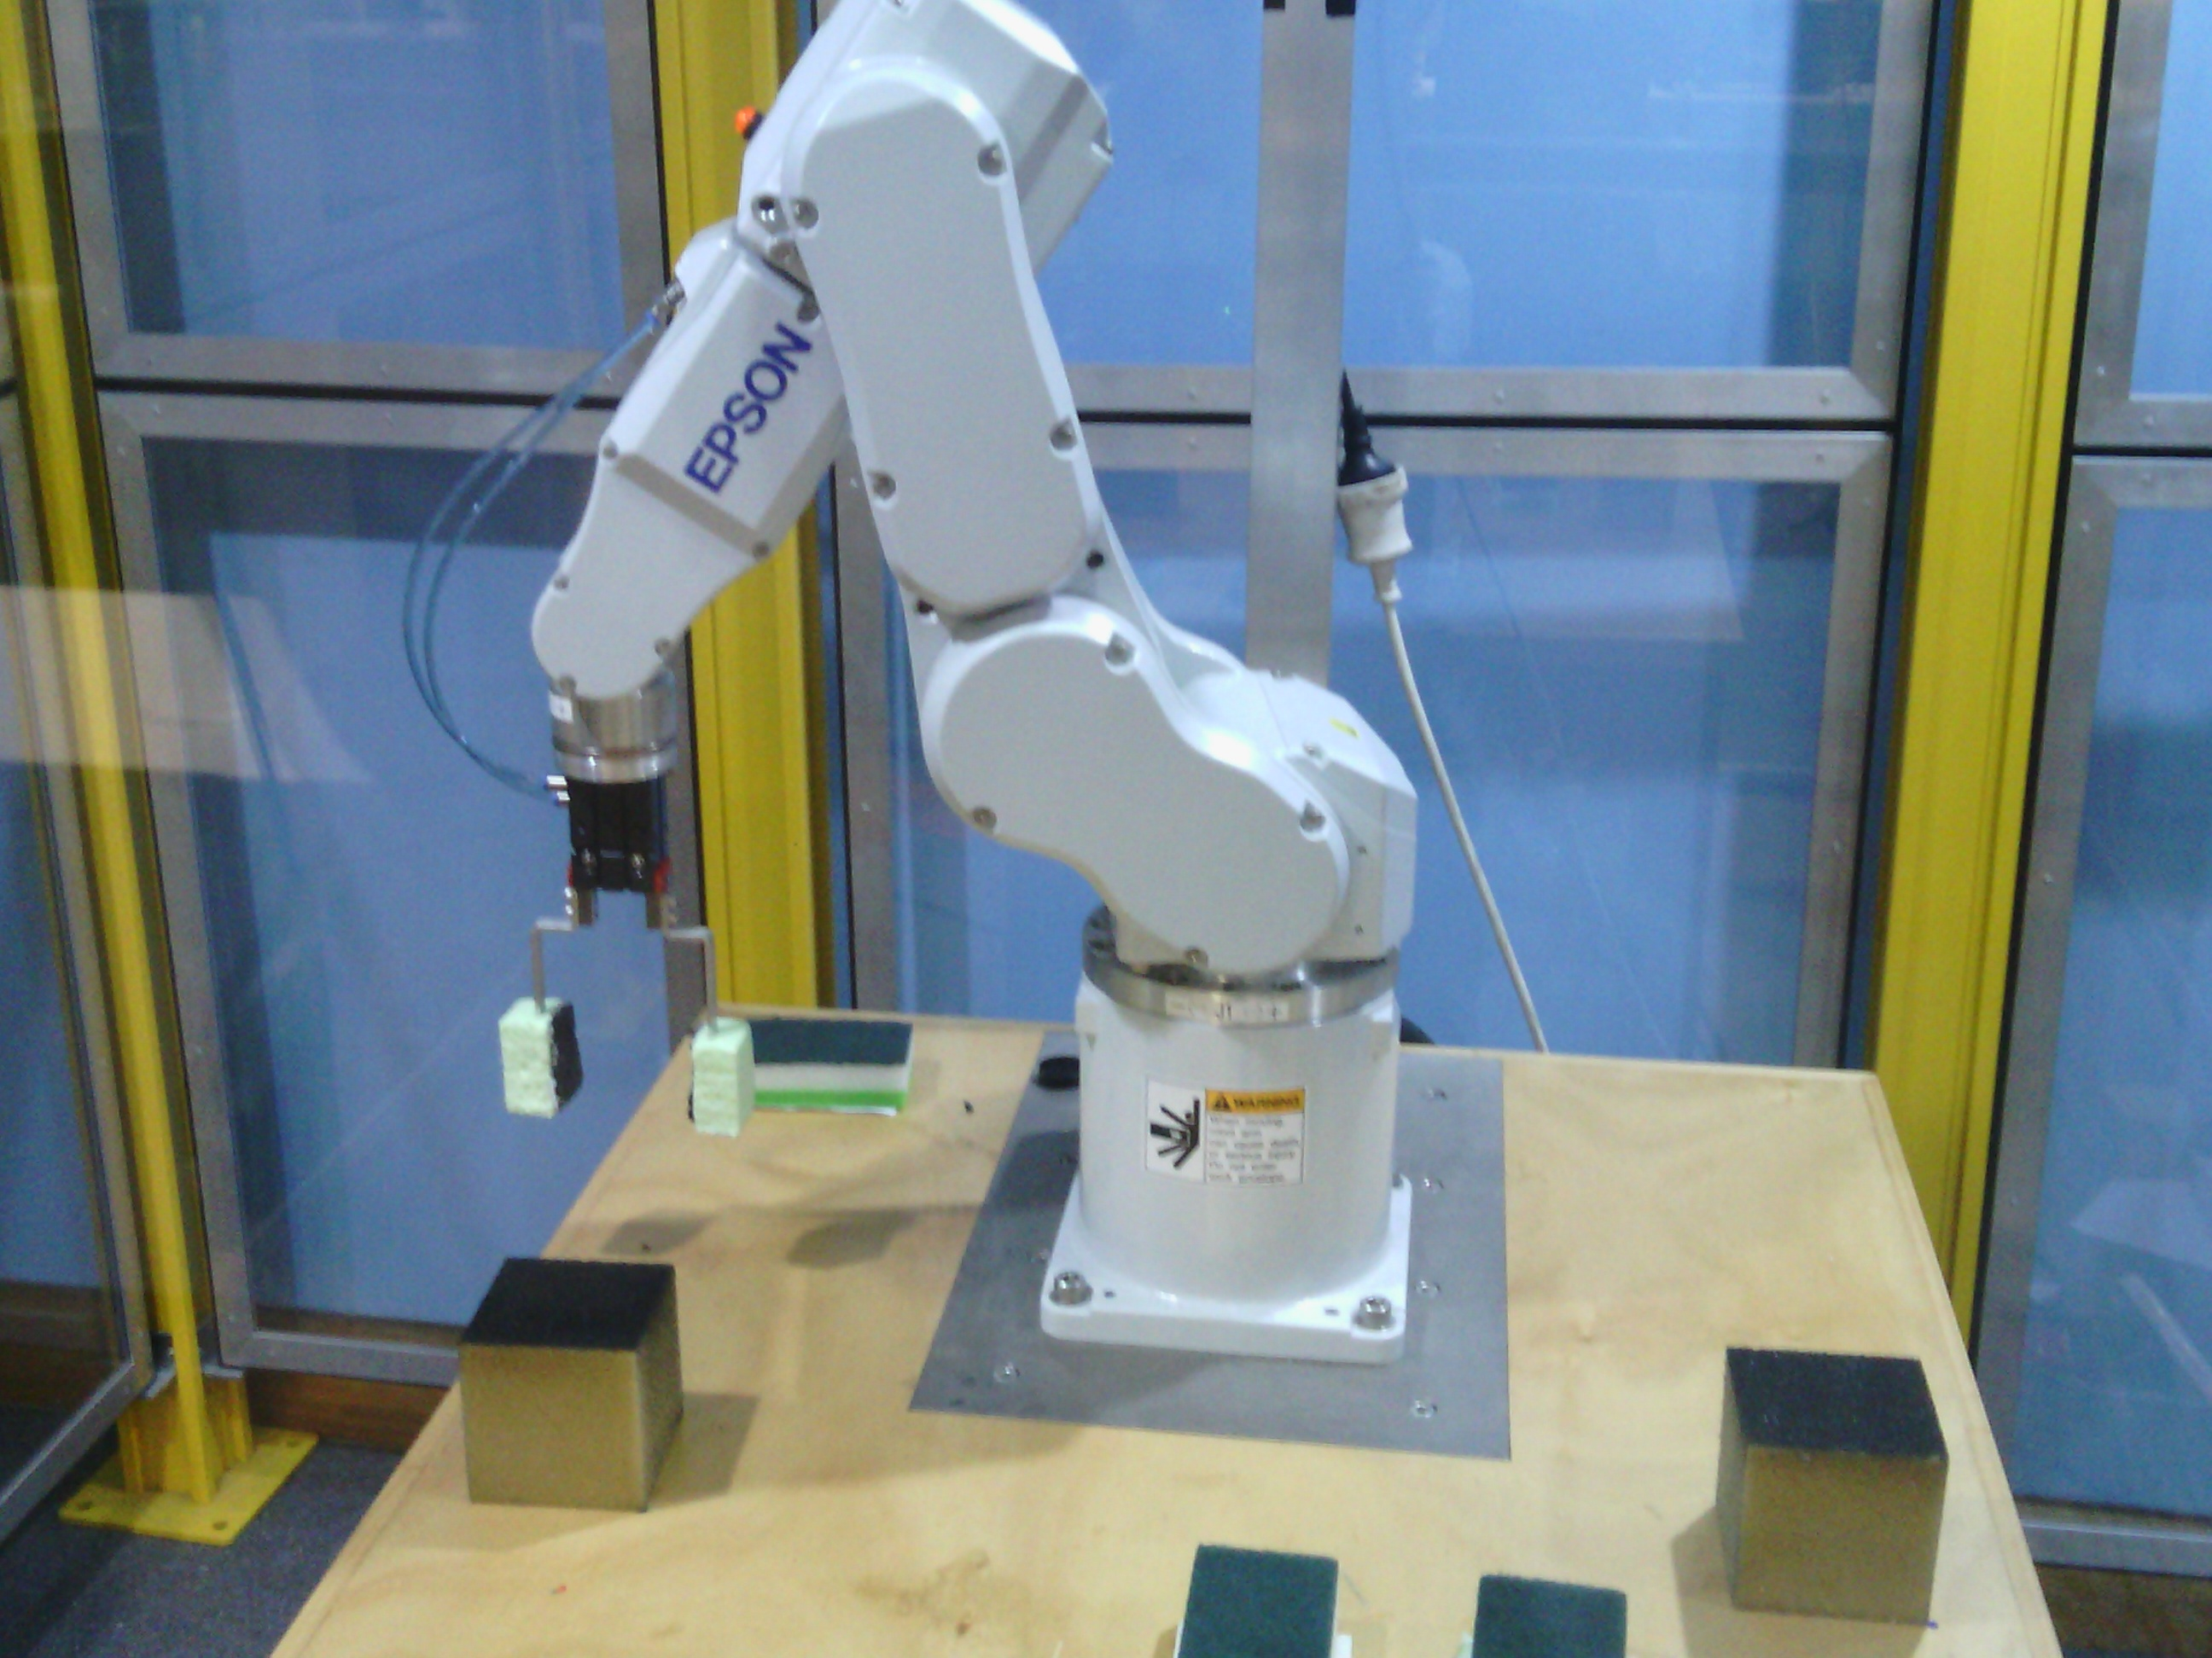
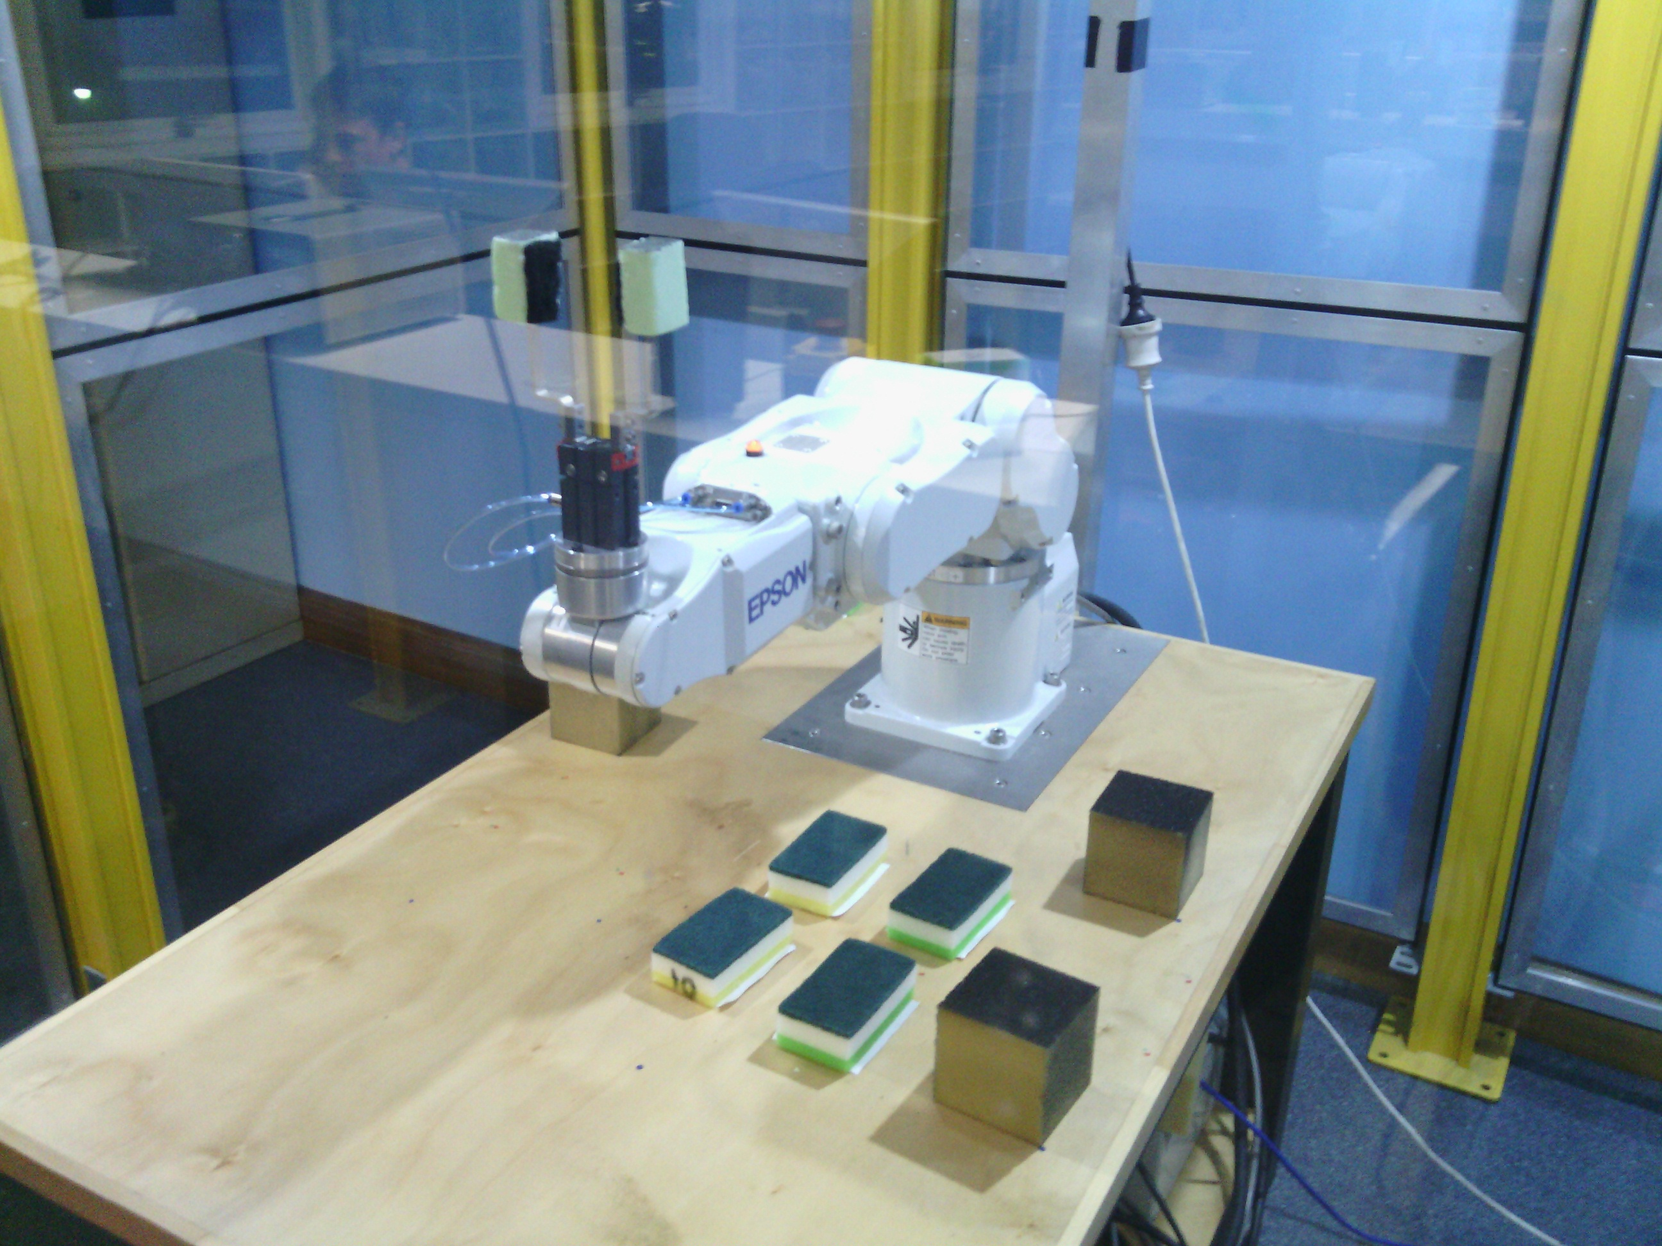
Movement Sequence
Certain actions had to have reversals
Hide Arm, Peek at Card
Returning to Home would result in illegal movements

Slide 14
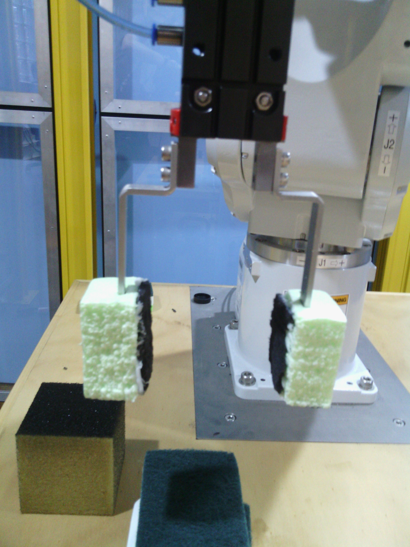
End Effector Design
Robust
Easily replaceable
Customisable

